Slide 1
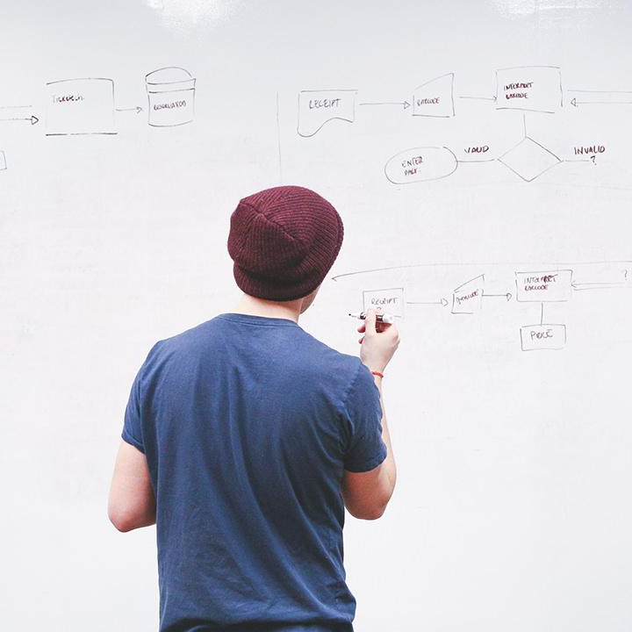
HELLO!
Here 1Crore Projects
I am here because I love to give presentations.
You can find me at @1CROREPROJECTS

Slide 2
Supporting Authorized Duplicate Check in hybrid Cloud Archilecture

Slide 3

AIM OF PROJECT
Data deduplication is one of important data compression techniques for eliminating duplicate copies of repeating data, and has been widely used in cloud storage to reduce the amount of storage space and save bandwidth. To protect the confidentiality of sensitive data while supporting deduplication, the convergent encryption technique has been proposed to encrypt the data before outsourcing

Slide 4
ABSTRACT
To better protect data security, this paper makes the first attempt to formally address the problem of authorized data deduplication. Different from traditional deduplication systems, the differential privileges of users are further considered in duplicate check besides the data itself. We also present several new deduplication constructions supporting authorized duplicate check in a hybrid cloud architecture. Security analysis demonstrates that our scheme is secure in terms of the definitions specified in the proposed security model.

Slide 5
INTRODUCTION
Cloud computing provides seemingly unlimited virtualized resources to users as services across the whole Internet, while hiding platform and implemen -tation details. Today’s cloud service providers offer both highly available storage and massively parallel computing resources at relatively low costs. As cloud computing becomesprevalent, an increasing amount of data is being stored in the cloud and shared by users with specified privileges,which define the access rights of the stored data.

Slide 6
EXISTING SYSTEM
Data duplication system,The private cloud is involved as a proxy to allow data owner/users to securely perform duplicate check with differential privileges
Such architecture is practical and has attracted much attention from researches.the data owner only outsource thier data storage by utilizing public cloud while the data operation is managed in private cloud

Slide 7
DISADVANTAGES
Can be lost or stolen in transit
More expensive than the look and demand a great deal of work from accounting staff

Slide 8
PROPOSED SYSTEM
The private keys for privileges will not be the private cloud server instead. In this way, the users can_x0002_not share these private keys of privileges in this proposed key sharing among users in the above straightforward construction.
To get a file token, the user needs to send a request to the private cloud server. The intuition of this con_x0002_struction can be described as follows. To perform the dupli_x0002_cate check for some file, the user needs to get the file token from the private cloud server.

Slide 9
ADVANTAGES
No set up costs or complex system to operate
Provide a relatively long float

Slide 10
ALGORITHM
ABE
Attribute-based encryption (ABE) can be used for log encryption. Instead of encrypting each part of a log with the keys of all recipients, it is possible to encrypt the log only with attributes which match recipients' attributes.

Slide 11
Cipher Text
Cipher text is also known as encrypted or encoded information because it contains a form of the original plaintext that is unreadable by a human or computer without the proper cipher to decrypt it. Decryption, the inverse of encryption, is the process of turning cipher text into readable plaintext.

Slide 12
SYSTEM ARCHITECTURE

Slide 13
MODULES
In this project has four modules:
Data Owner
Shared Users
Cloud
Authority

Slide 14
DATA OWNER
Register the account with the basic information
After authorize user can login the account with correct username and password
Upload the file with the encryption format using the ABE –CR algorithm
View user request and Make a request for re-encryption
View the status and Re-Encrypted the key
Logout

Slide 15
USER
Register the account with the basic information
After authorize user can login the account with correct username and password
View Profile
Send Download request
Download file
Logout

Slide 16
CLOUD SERVICE
Login the account with the correct username and password
View all uploaded files
View Re-Encryption request and Send the Responses
View all downloaded files
Graph
Logout

Slide 17
AUTHORITY
Authority can login the account with the correct Credentials
View users and owners authorize them
View user Download request and Send the Key
Logout

Slide 18
MOTIVATIONS
Enables fine-grained encrypted data sharing while keeping the confidentiality of the underlying data.
Enables the shared user to verify the correctness of the re-encrypted ciphertext returned from the cloud server.

Slide 20
HARDWARE REQUIREMENTS
System | Intel i3 and above
Hard Disk | 40GB
RAM | Minimum 4GB
Processor | 64-bit, four-core, 2.5 GHz minimum per core

Slide 21
SOFTWARE REQUIREMENTS
Front End Language | HTML, CSS, JAVA, JSP SERVELTS
Backend | My SQL
Operating System | Windows 10 or 11
IDE | JAVADEVELIPEMENKIT

Slide 22
FUTURE WORK
For our future work, we will try to implement this methods using the different algorithms in the real Cloud like AWS, Azure etc.

Slide 23
CONCLUSION
This project introduces the verifiability and fairness security requirements for attribute-based data sharing in clouds and put forward a notion of verifiable and fair ciphertext policy attribute-based proxy re-encryption(VF-CP-ABPRE).
The scheme provides the ability for a shared user to verify the validity of the re-encrypted ciphertext
We also conducted an implementation to evaluate our proposed scheme, and compared the execution time between our scheme and previous schemes to demonstrate the efficiency of the proposed VF-CP-ABPRE scheme

Slide 24
REFERENCE
A. Kapadia, P. P. Tsang, and S. W. Smith, “Attribute-based publishing 888 with hidden credentials and hidden policies.” in NDSS, vol. 7. Citeseer, 889 2007, pp. 179–192. 890
M. Blaze, G. Bleumer, and M. Strauss, “Divertible protocols and atomic 891 proxy cryptography,” in International Conference on the Theory and 892 Applications of Cryptographic Techniques. Springer, 1998, pp. 127– 893 144. 894

Slide 25
G. Ateniese, K. Fu, M. Green, and S. Hohenberger, “Improved proxy 895 re-encryption schemes with applications to secure distributed storage,” 896 Acm Transactions on Information and System Security, vol. 9, no. 1, pp. 897 1–30, 2006. 898
S. Ohata, Y. Kawai, T. Matsuda, G. Hanaoka, and K. Matsuura, “Re- 899 encryption verifiability: How to detect malicious activities of a proxy in 900 proxy re-encryption,” in Cryptographers Track at the RSA Conference. 901 Springer, 2015, pp. 410–428

Slide 26
THANKS!
Any questions?
You can find me at
Reach us – 1croreprojects@gmail.com
Contact / Whatsapp: 7708 150 152 / 9751 800 789 / 790 432 0834

